Slide 1

The Thermo Lignum® Process
A Humidity Controlled Warm Air Process to combat
Dry Wood Termites and other Insect Pest Infestations
Nikolaus Wilke, August 2014, Angra do Heroismo

Slide 2
Different Types of Treatment
Treatment of fine arts and antiques in chamber or si-situ tents with exactly controlled relative humidity (RH)
Treatment of buildings with added humidity
Simple building construction treatment without humidity
Key Question: Which sort of object needs treatment?
A pile of raw wooden construction beam?
or
An exquisitely painted ceiling or gilded sculpture?
Source: Becker und Loebe 1961

Slide 3
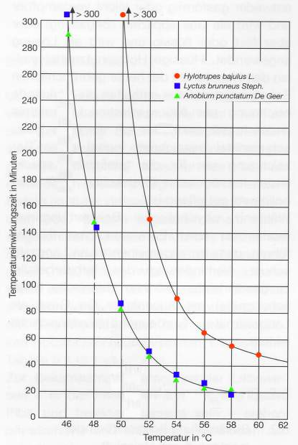
The Idea
Pests such as dry wood termites, woodworm, moths, carpet beetle, etc. are temperature sensitive.
The majority of insects at any of the various stages of their life cycle will die if they are subject to temperatures above 50°C for an extended period. Dry wood termites die at 49°C.
→ Warm up the objects
Source: Becker und Loebe 1961

Slide 4
Damage to objects because of
Your concerns
Dimensional change due to swelling or shrinkage
Excessive temperature differences in the object

Slide 5
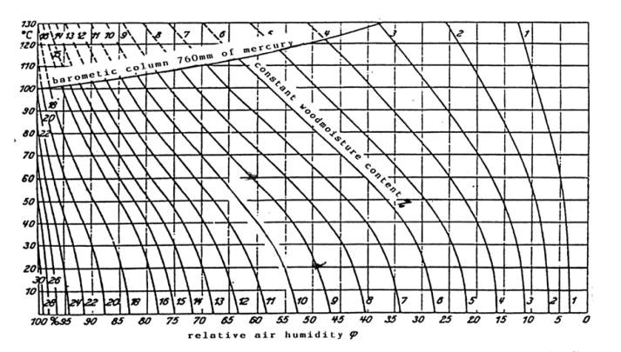
The solution – Keylwerth Diagramm
Context of temperature, RH and moisture in an object
Notes:
Um den Gehalt von freiem und gebundenem Wasser in Holz während der Erhöhung der Temperatur konstant zu halten, muss die relative Feuchte nach dem Kylwerthschen Diagramm erhöht werden

Slide 6
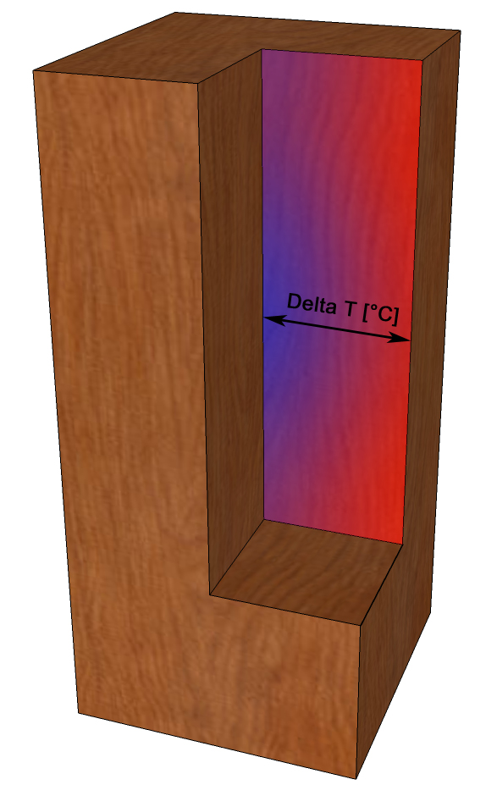
The solution
Maintain low temperature differences between surface and core
Measure the core temperature
Define a temperature difference
Control the chamber temperature

Slide 7
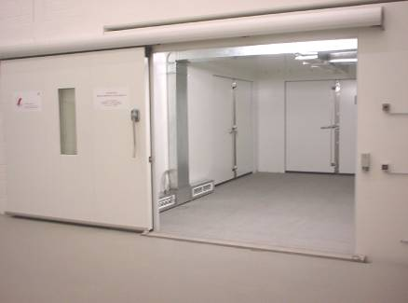

Pull it all together
The Thermo Lignum® Chamber Technology
Schematic representation of the process
time
warming phase
Treatment phase
Cooling phase
rh%
< 60°C
≥ 55°C
°C
- t
Mind. 1 Std
Core temperature °C
Cell temperatur °C
Relative humidity %

Slide 8
The Thermo Lignum® process
Process diagram of a Thermo Lignum® chamber
Duration = 18 – 24 hours
Holding phase
Warming phase
Cooling phase
t
t
Cell or
Chamber temperature
Core temperature
Relative Humidity

Slide 9
Again: Different Types of Treatment
Treatment of fine arts and antiques in chamber or si-situ tents with exactly controlled relative humidity (RH)
Treatment of buildings with added humidity
Simple building construction treatment without humidity
Key Question: Which sort of object needs treatment?

Slide 10
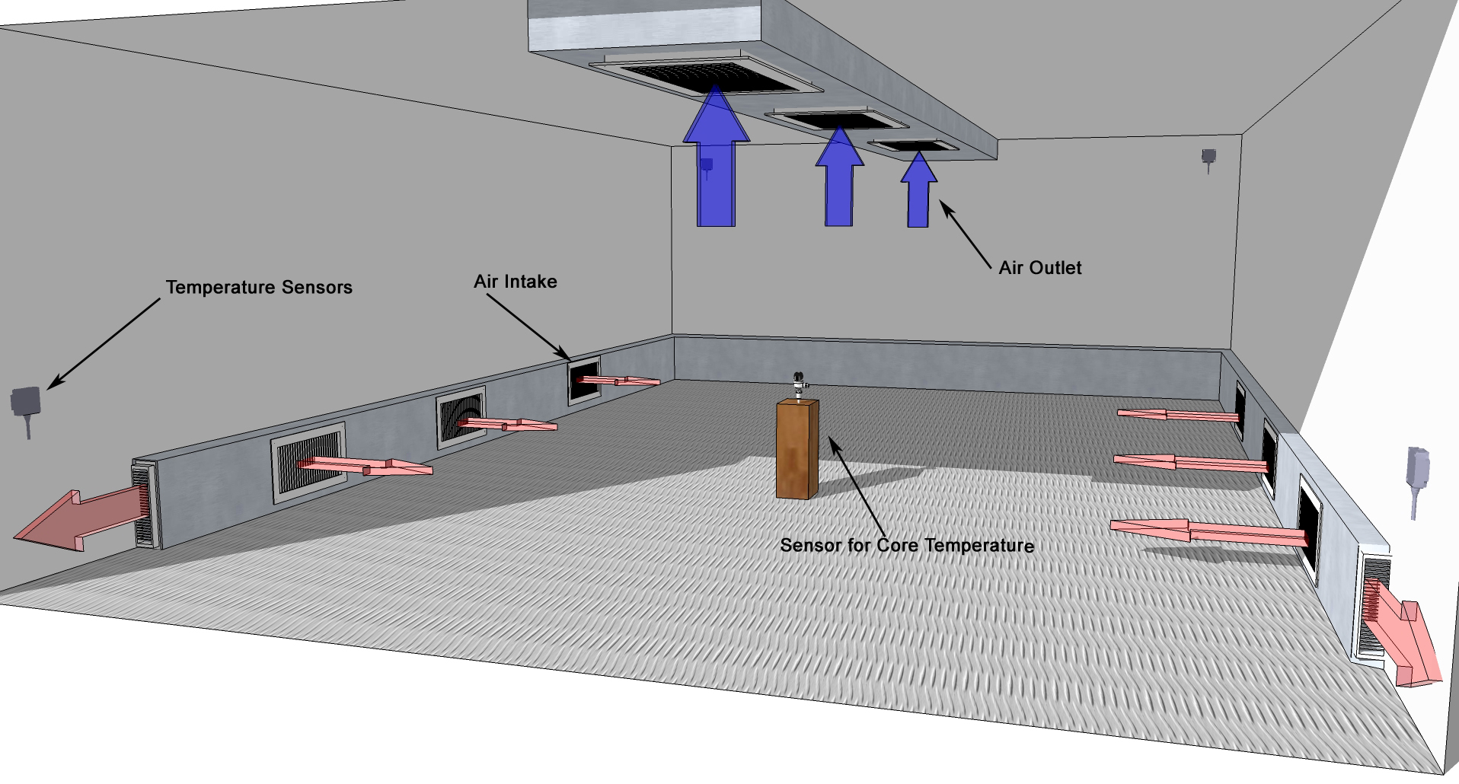
Chamber Treatment

Slide 11
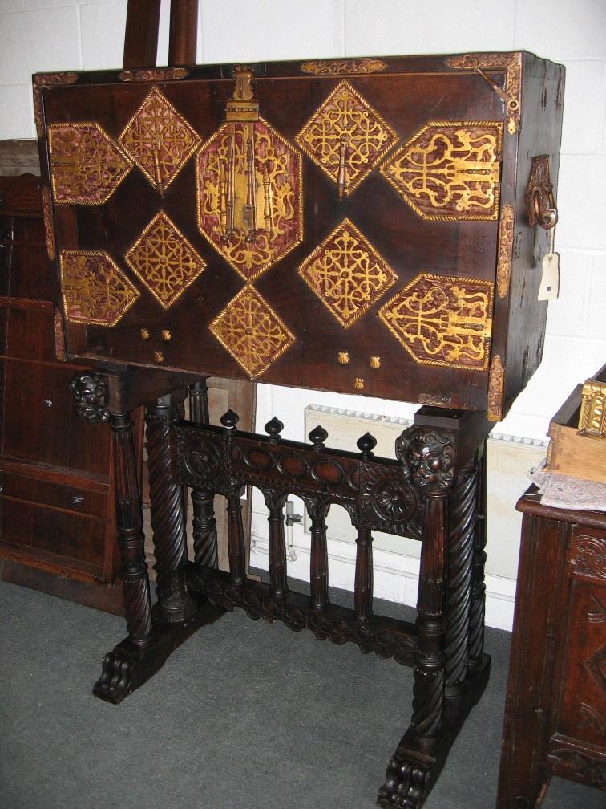
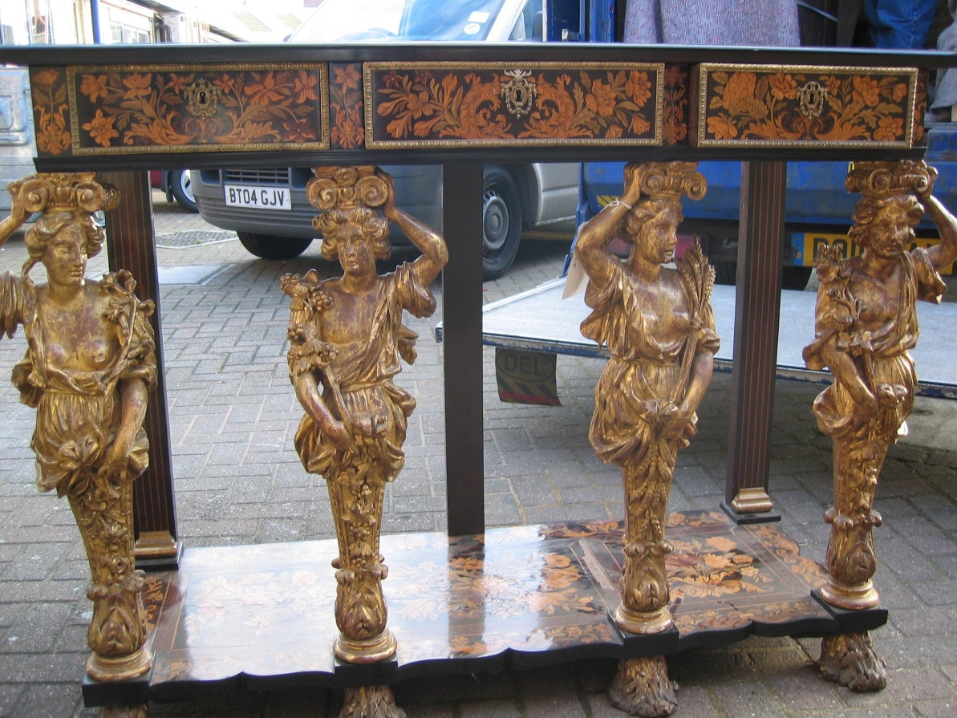
Examples for chamber Treatment
Antique furniture
England, 17th century, veneered wood, gilded figurines
China, 17th century, wood, brass

Slide 12
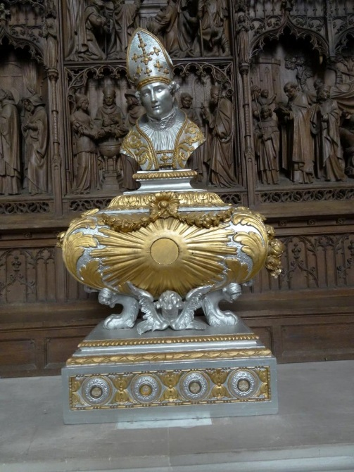
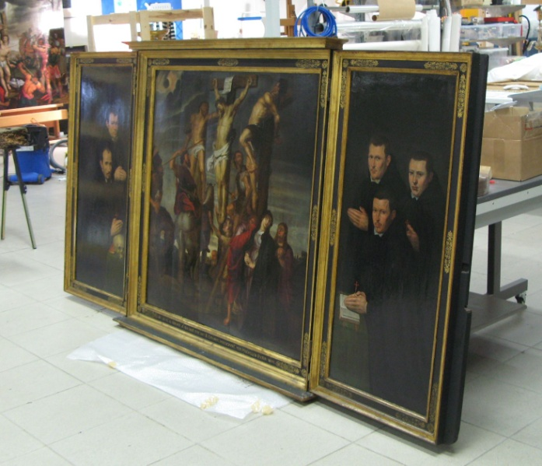
Examples for chamber Treatment
Highly sensitive paintings and polychrome gilded and painted sculptures and panel paintings
Belgium, 19th century, wood, gold & silver leaf
Flemish Triptych, dated 1633, oil paint on wood, gold leaf

Slide 13

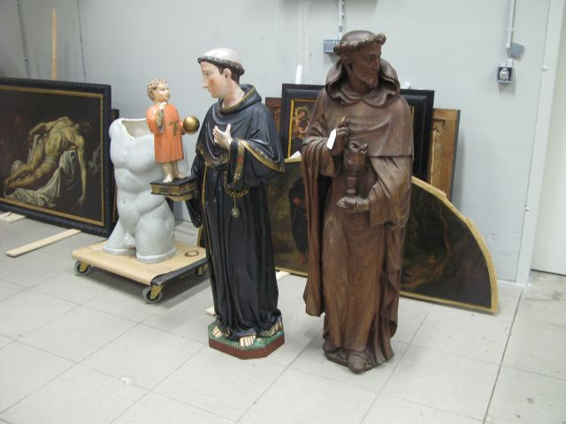
Examples for chamber Treatment
Highly sensitive paintings and polychrome gilded and painted sculptures
Various wooden painted and gilded sculptures, paintings & picture frames from Brussels Museums
Spain, Jerome, 16th century, oil on canvas

Slide 14
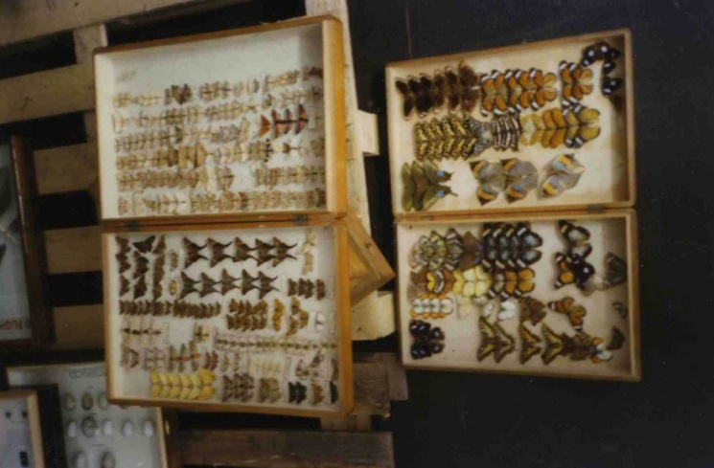
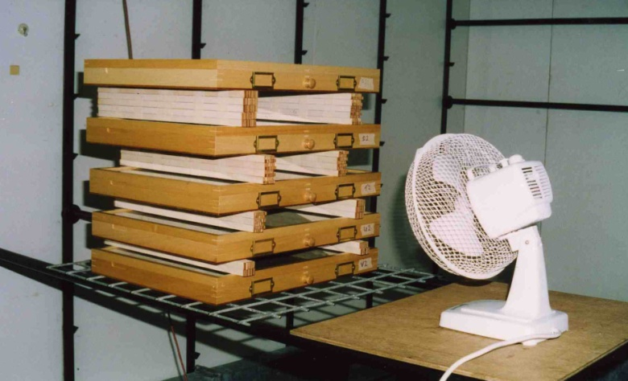
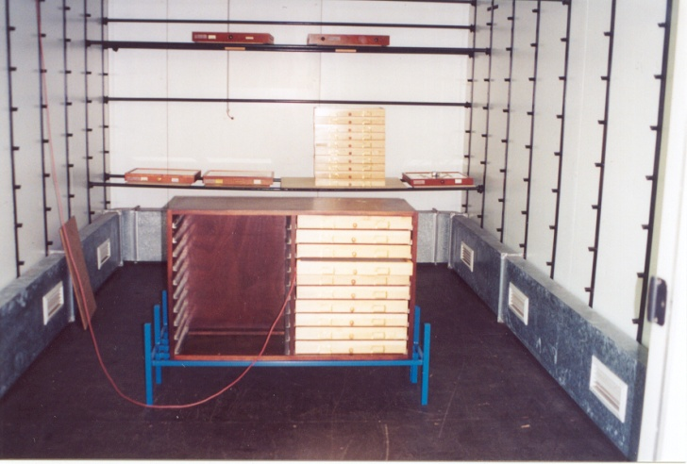
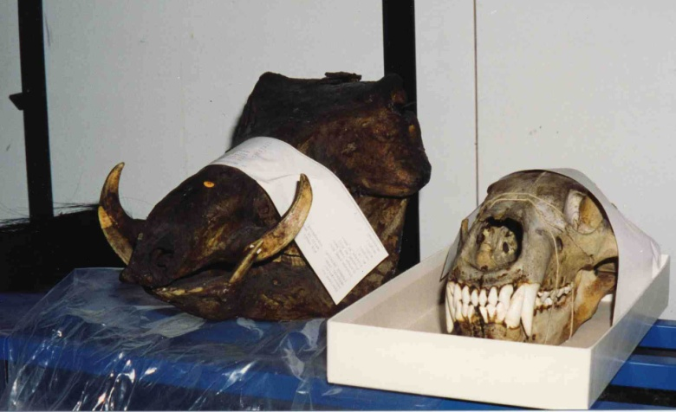
Examples for chamber Treatment
Natural history specimens at London Museum of Natural History
Entomological drawers, NHM London
Entomological drawers, NHM London
Entomogical drawers, NHM London
Natural History Specimens NHM London

Slide 15
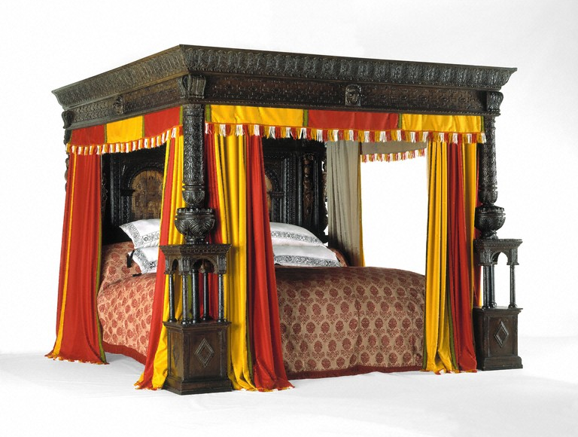
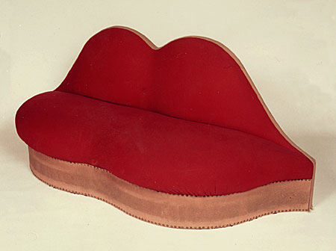

Examples for chamber Treatment
Salvador Dali, Lip Sofa, V&A
Great Bed of Ware, V&A, London
Yamamoto, V&A, London

Slide 16
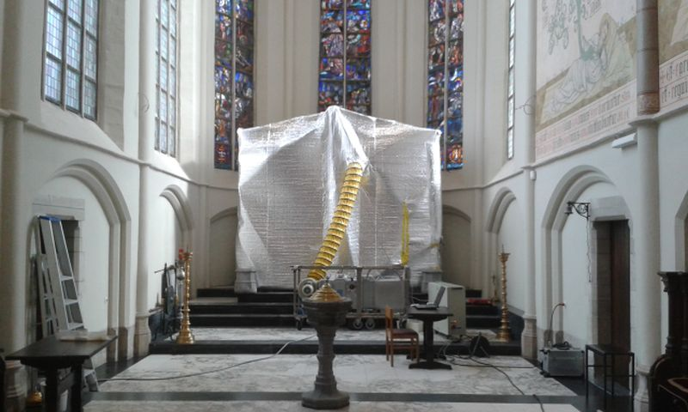
In-situ treatments allow good climate control
In-situ treatment
In-Situ treatment of neo gothic altar, Church Sint Lenaards, Brecht, Belgium

Slide 17
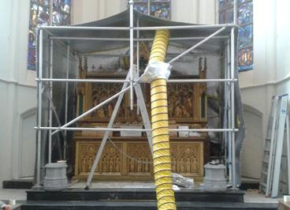
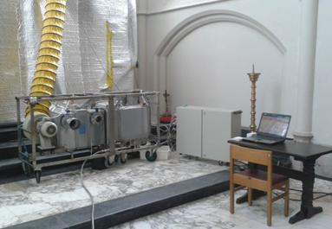
In-situ tent with mobile processor
Mobile TL processor and control unit with PC
In-situ tent with gilded neo gothic altar

Slide 18
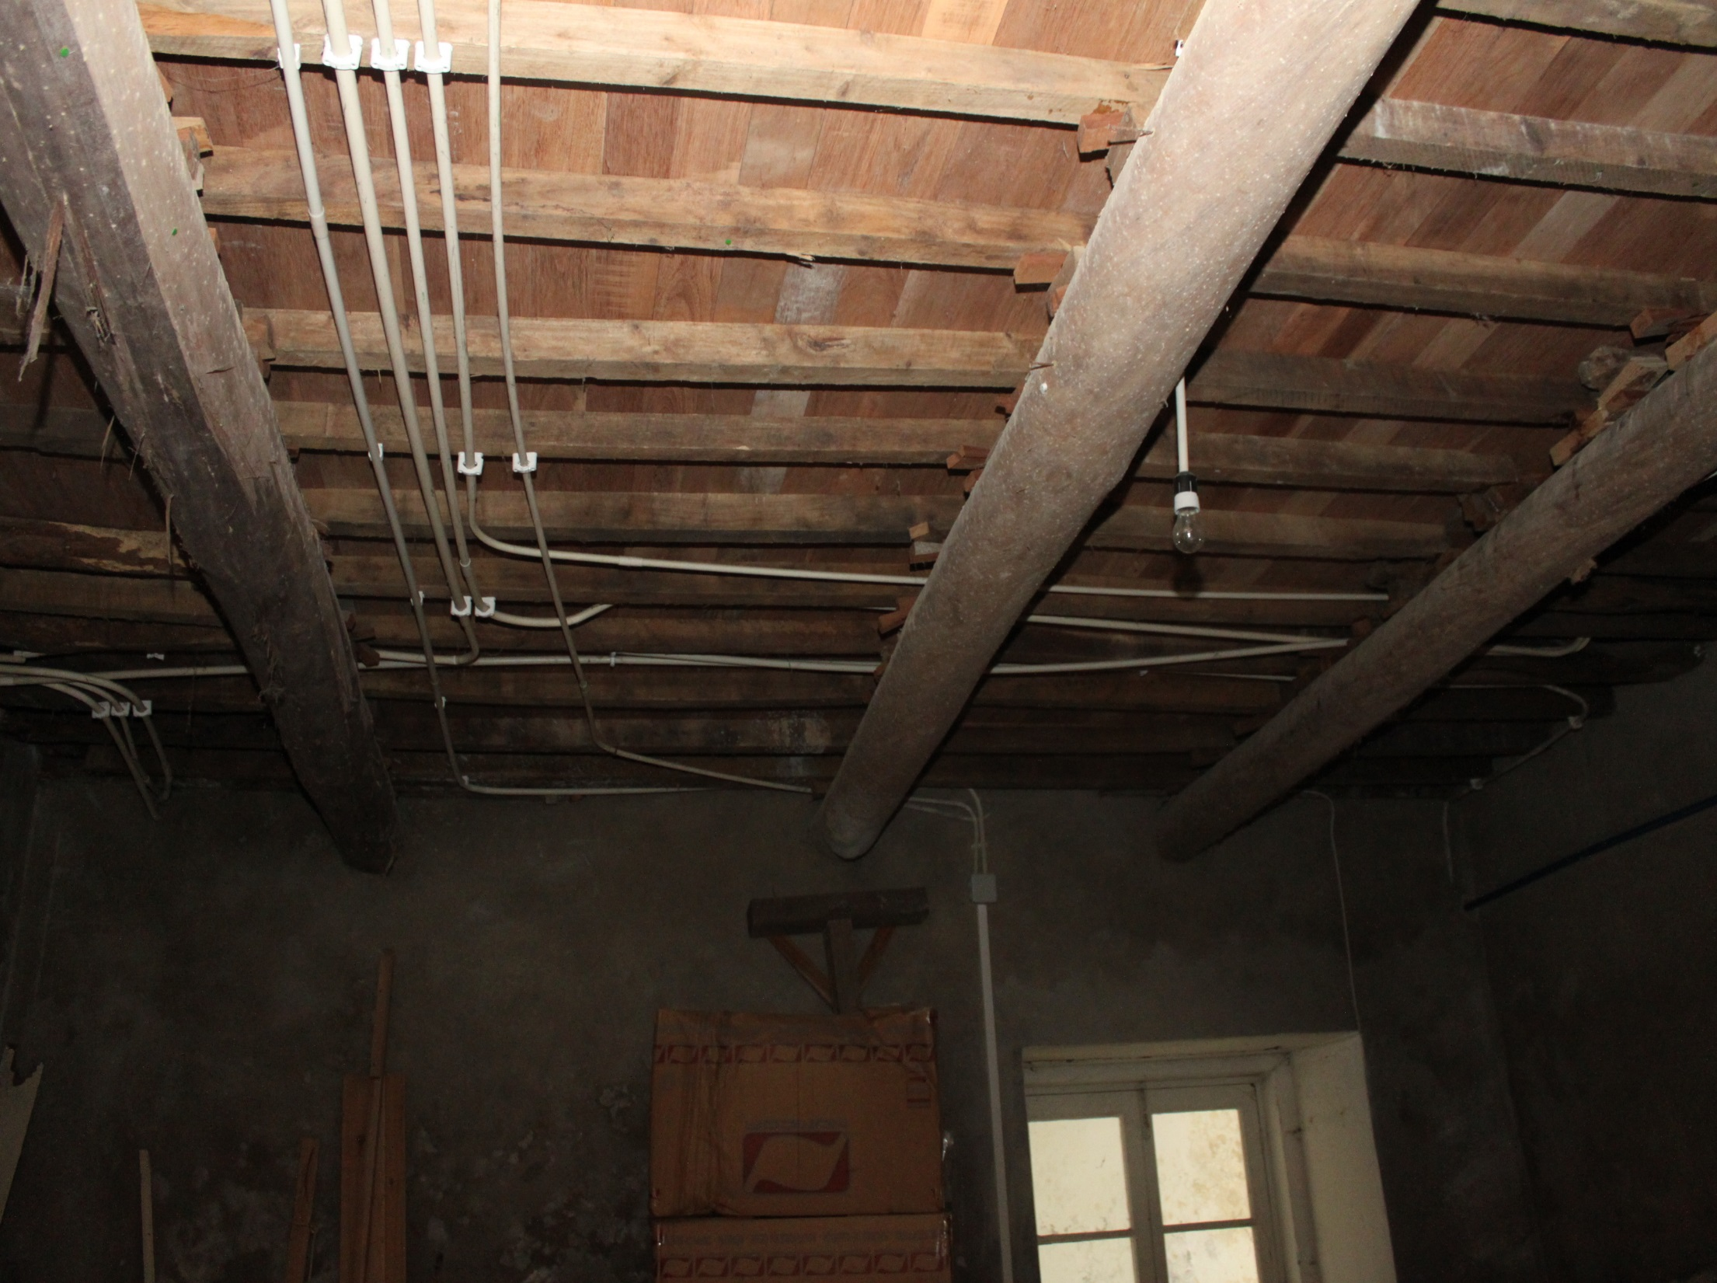
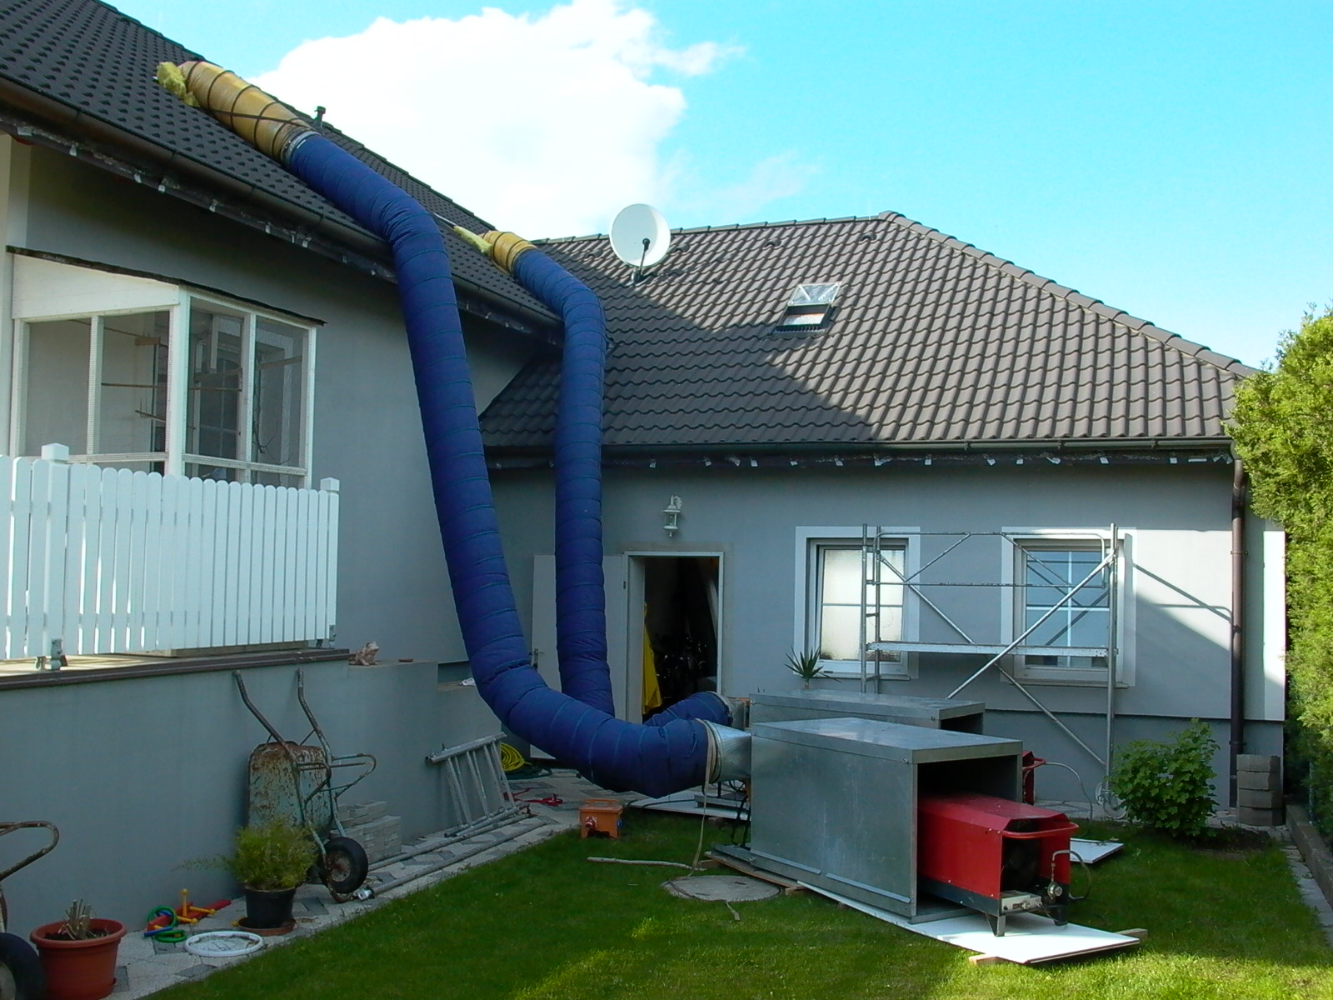
Building Treatment without added humidity
80-90°C over a period of
1 – 10 days depending on seize of object
Notes:
18

Slide 19
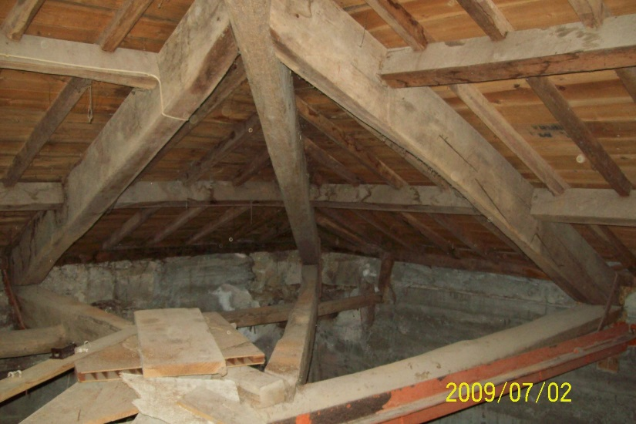
Building treatment without added humidity

Slide 20
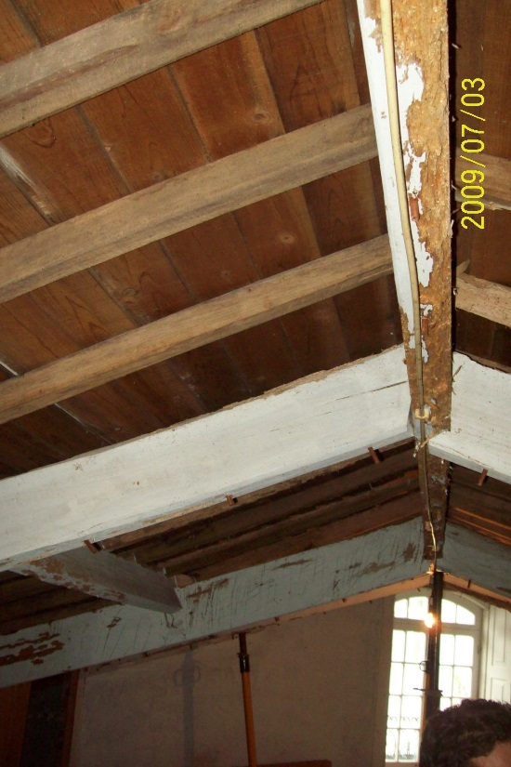
Building treatment without added humidity

Slide 21
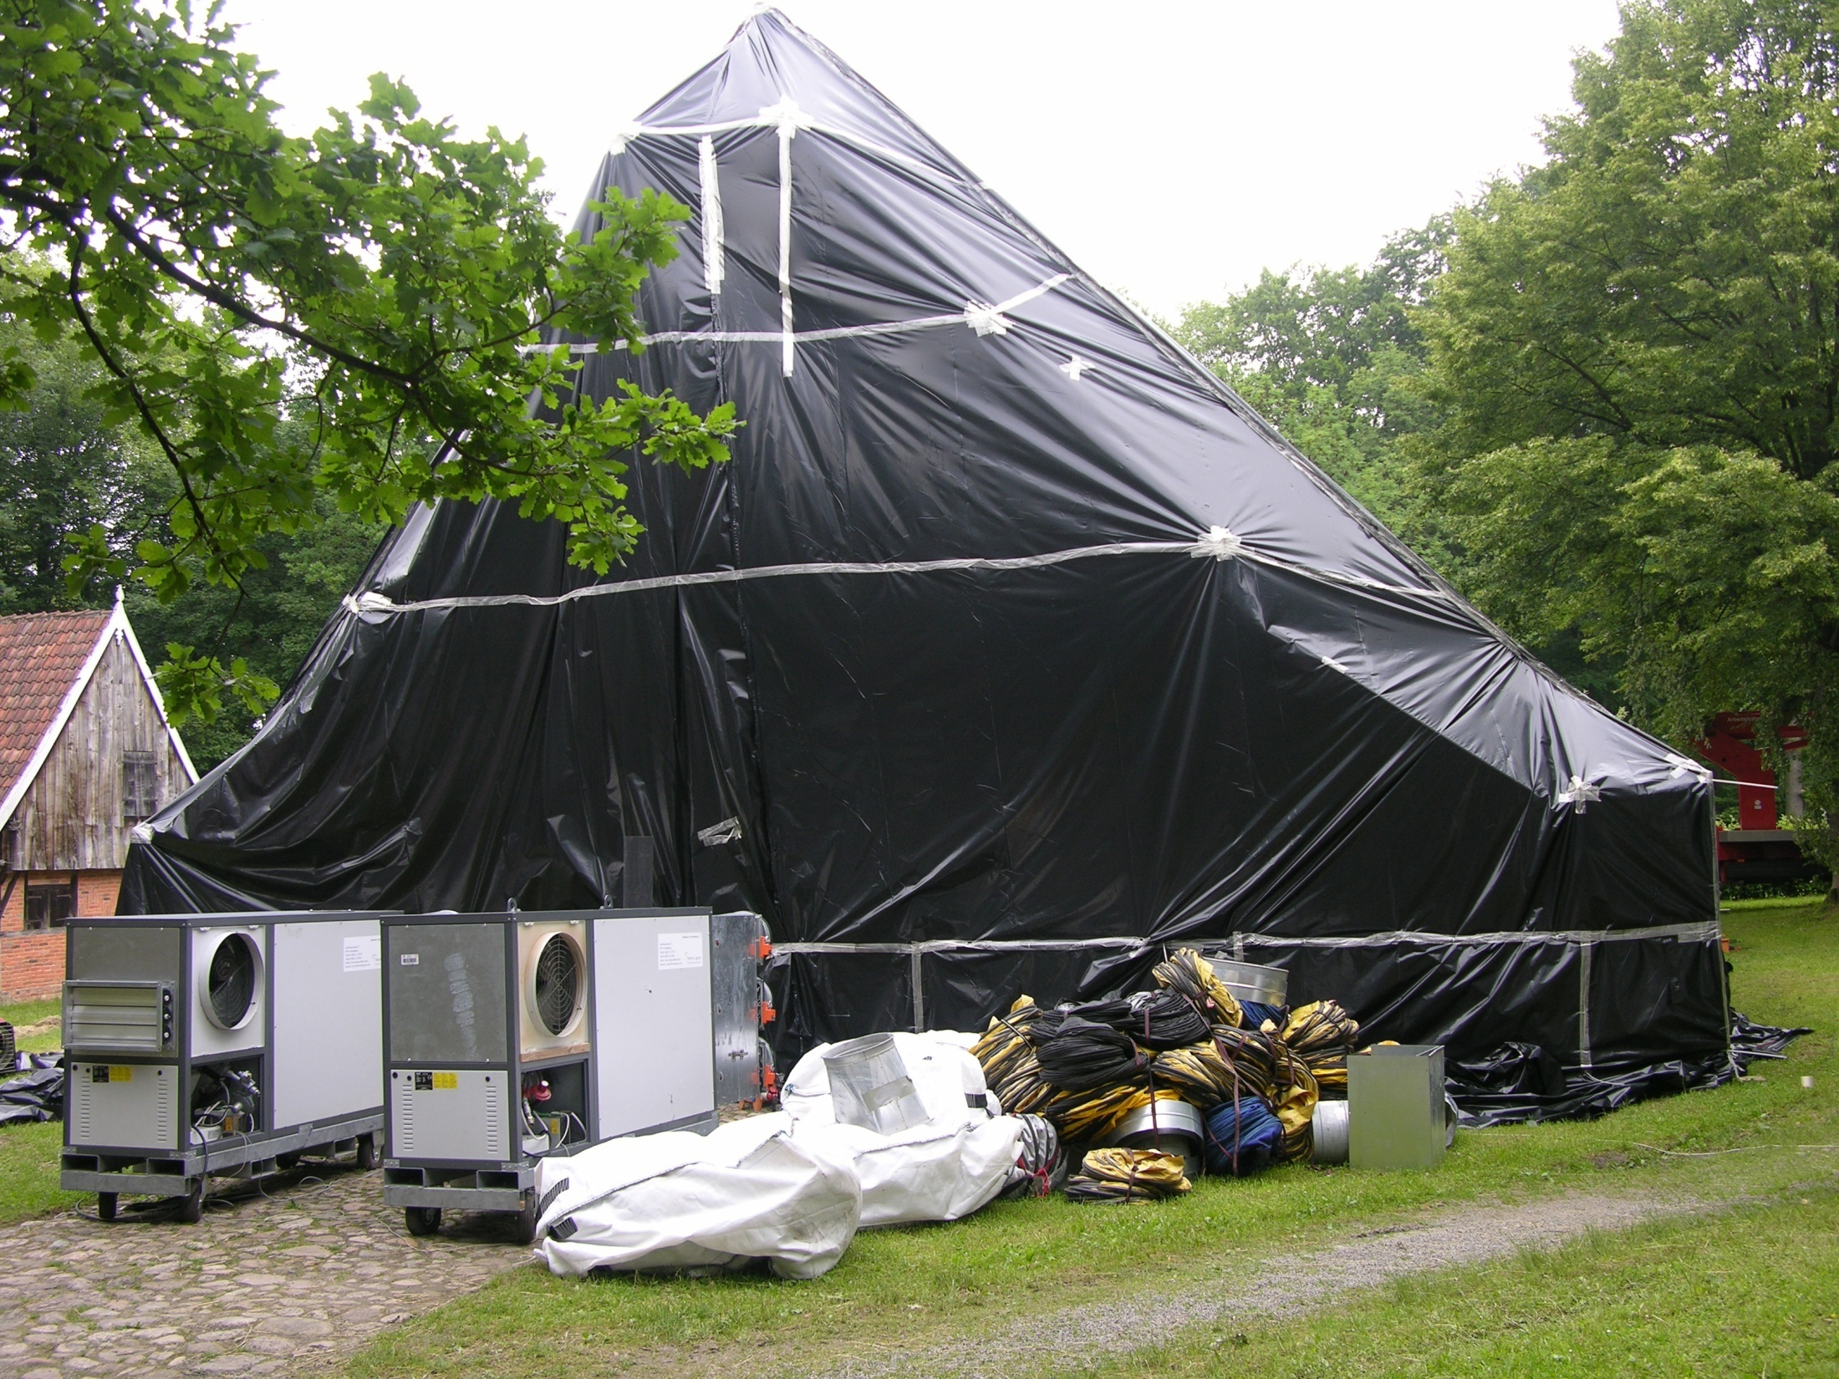
Building Treatment with added humidity 70-75°C over a period of 3 – 9 days depending on object
Notes:
21

Slide 22
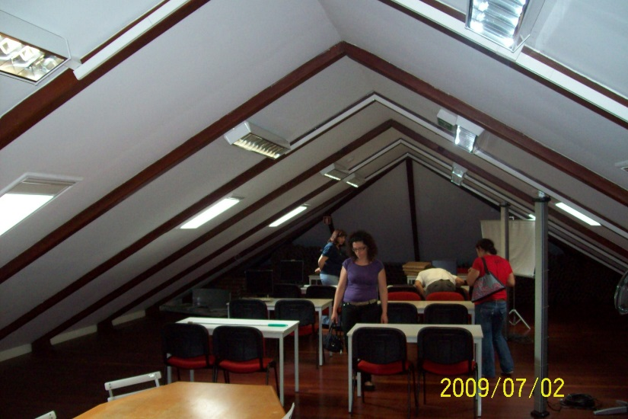
Building treatment with added humidity

Slide 23
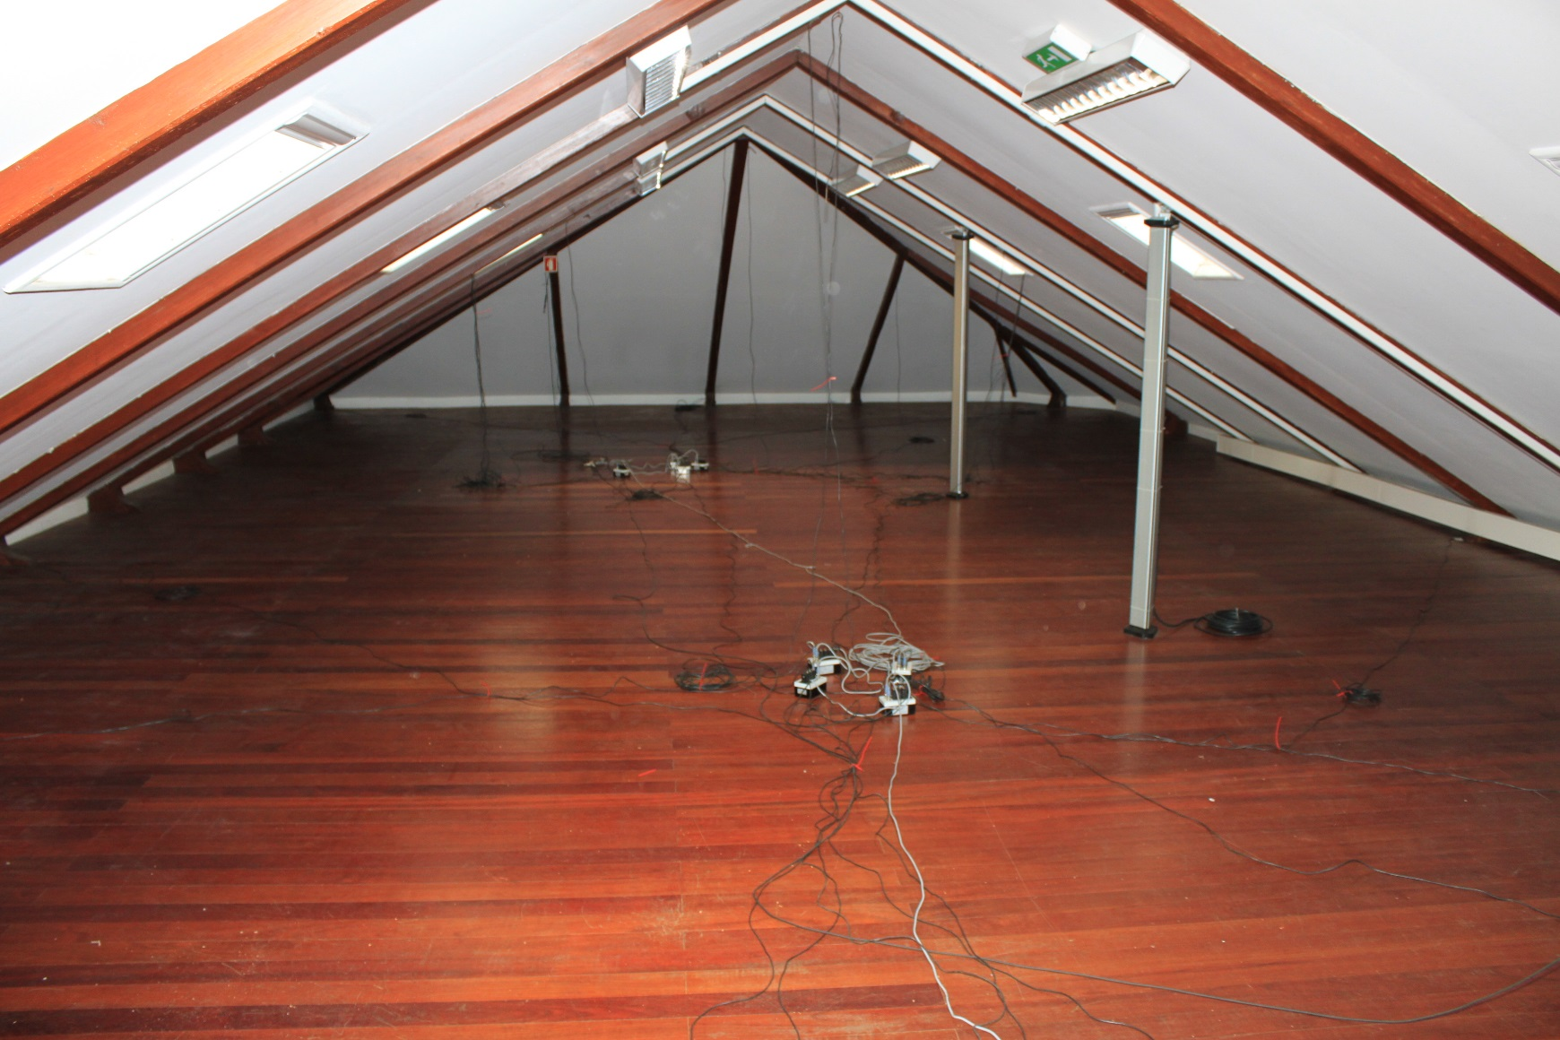
Building treatment with added humidity

Slide 24
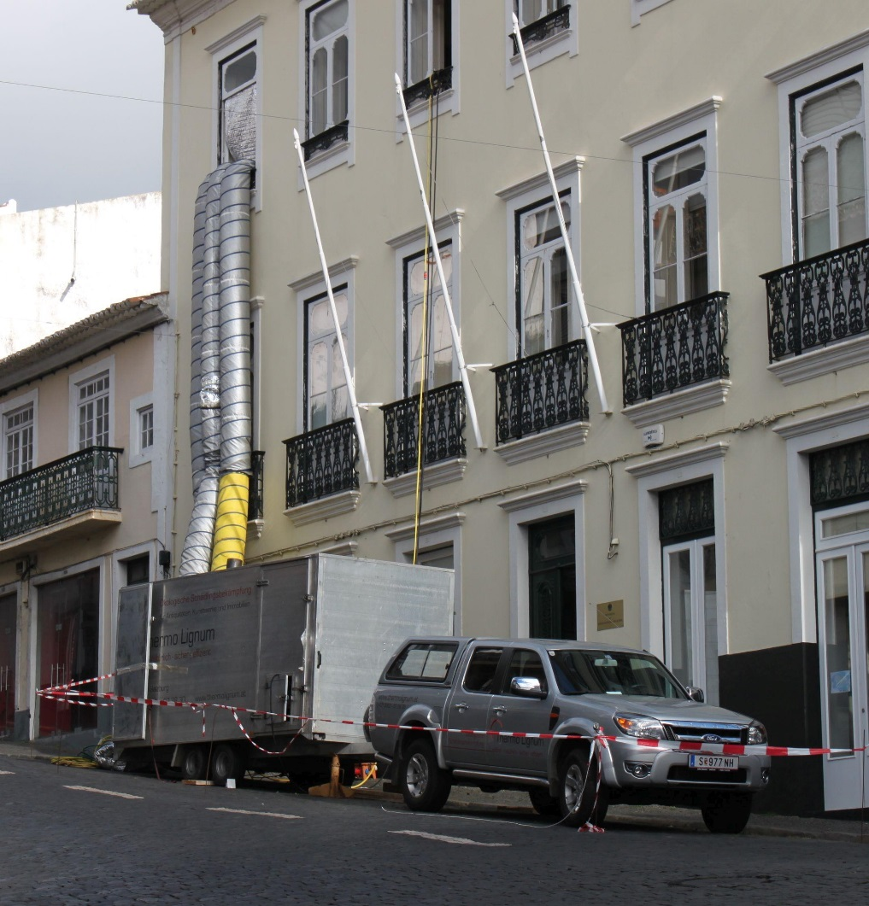
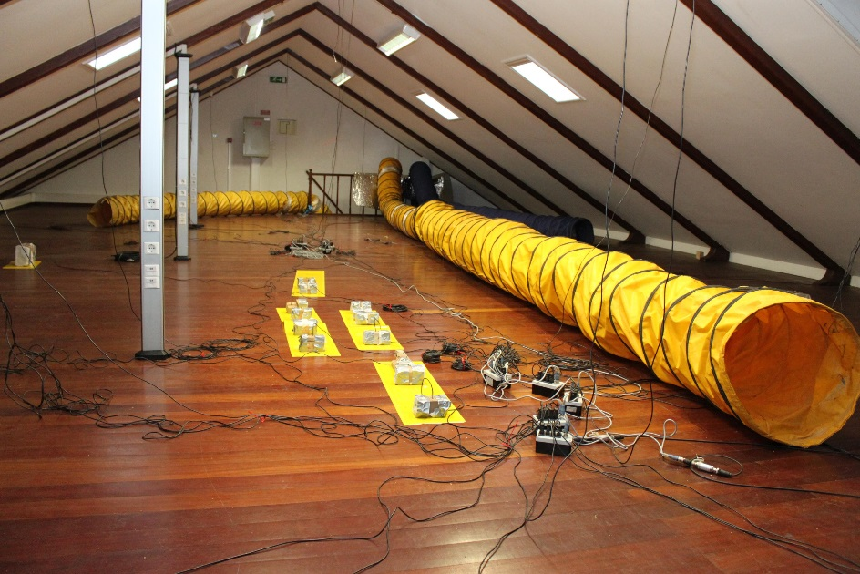
Building Treatment with added humidity
Building Treatment Angra de Heroismo, 2011
Building treatment, live termite control blocks, hoses, teperature sensors

Slide 25
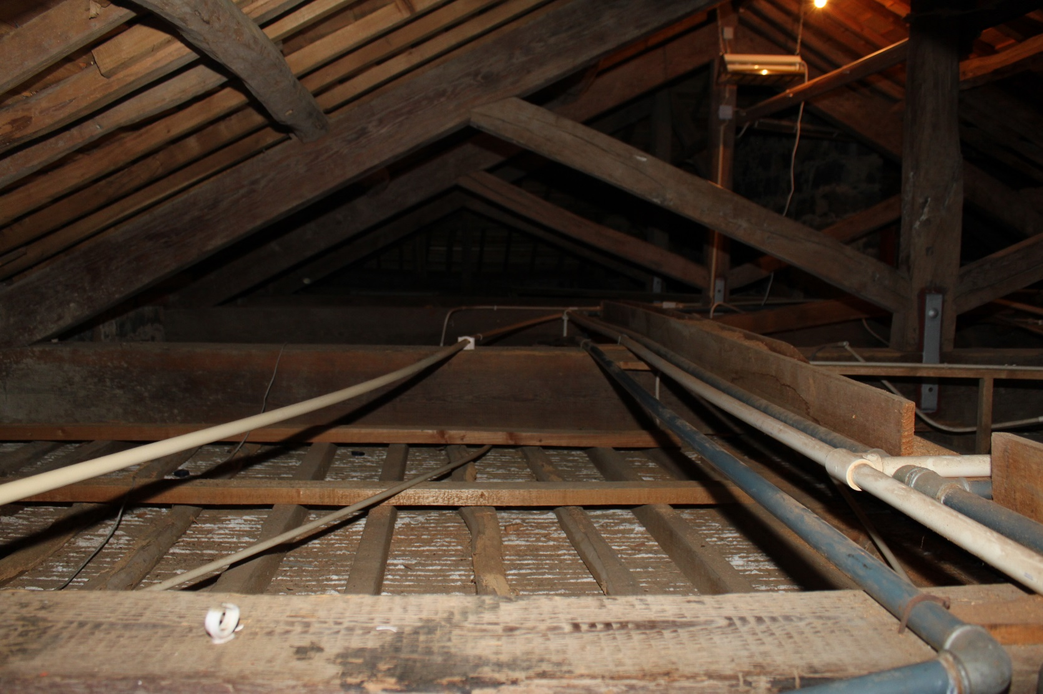
Combining in-situ and humidified building treatment
This looks like a simple job from above. But look at what‘s underneath:

Slide 26
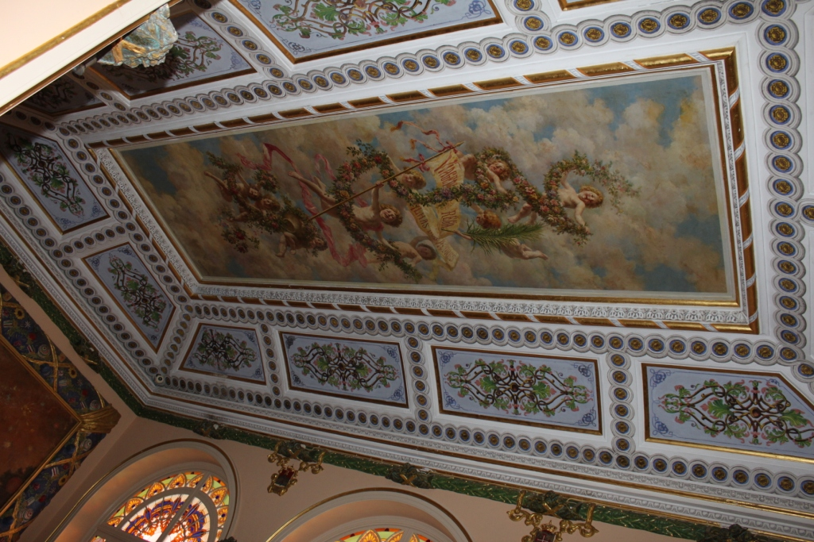
Combining in-situ and humidified building treatment

Slide 27
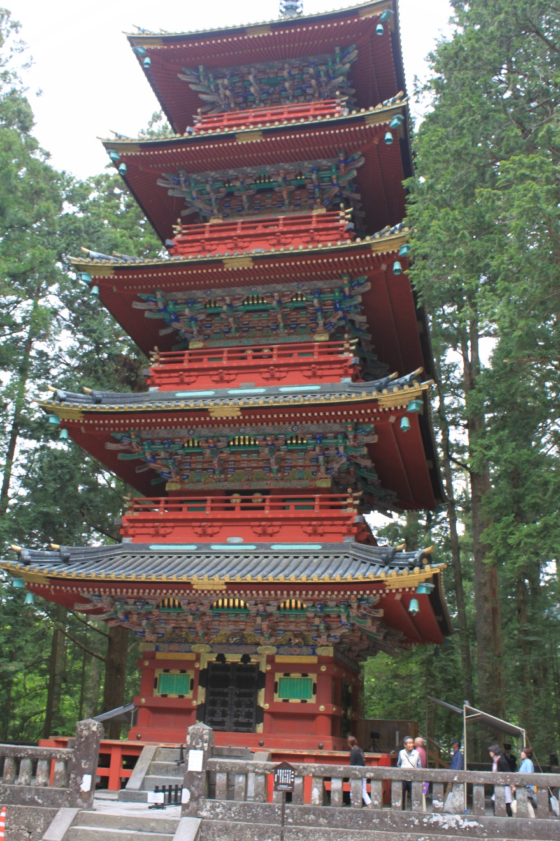
Japan temples need humidification

Slide 28
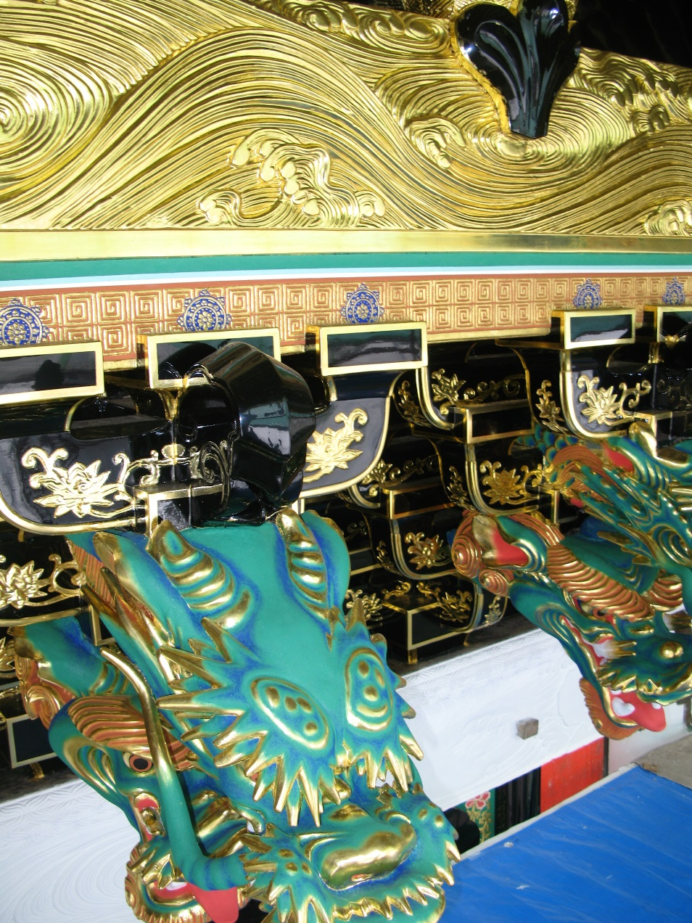
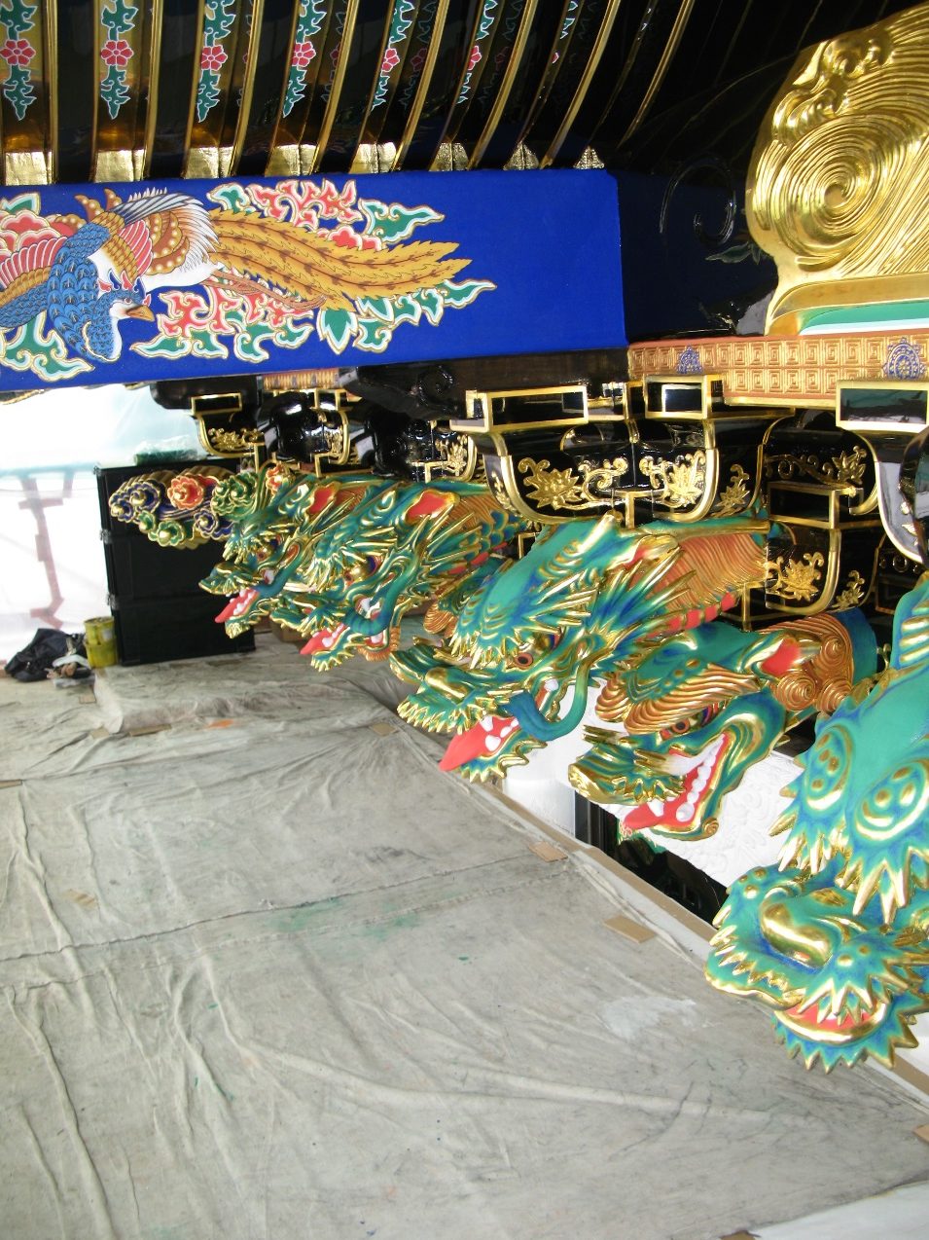
Excursion to Nikko Temples, Japan, May 2014

Slide 29
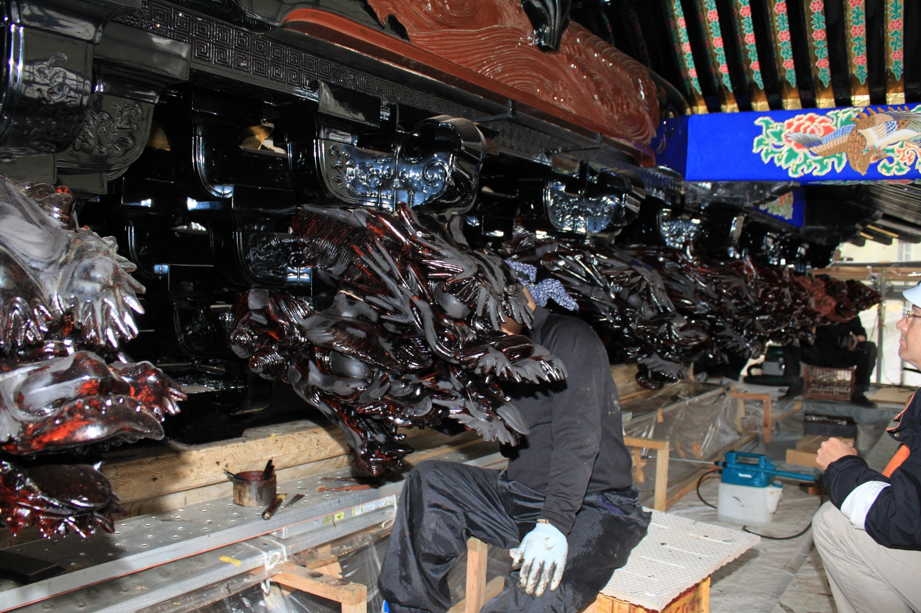
Excursion to Nikko Temples, Japan, May 2014

Slide 30
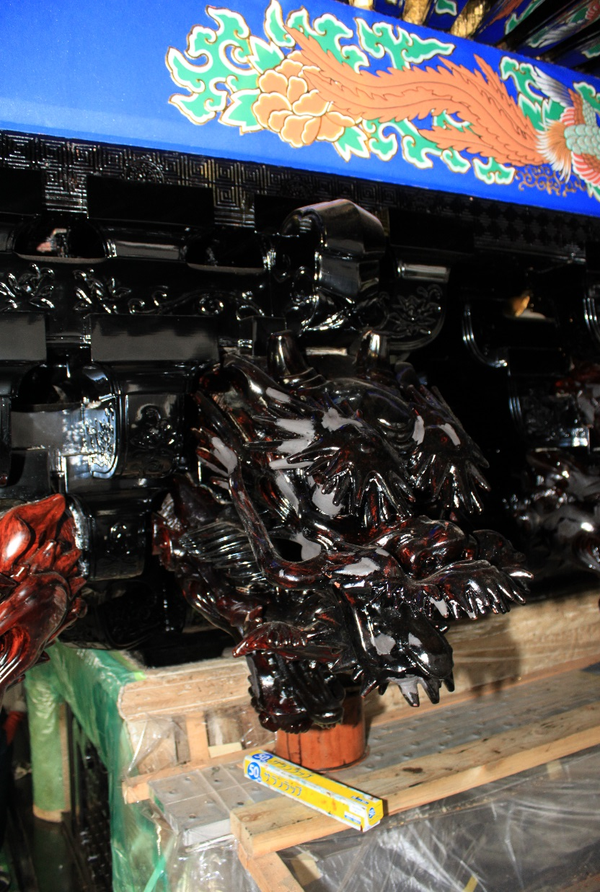
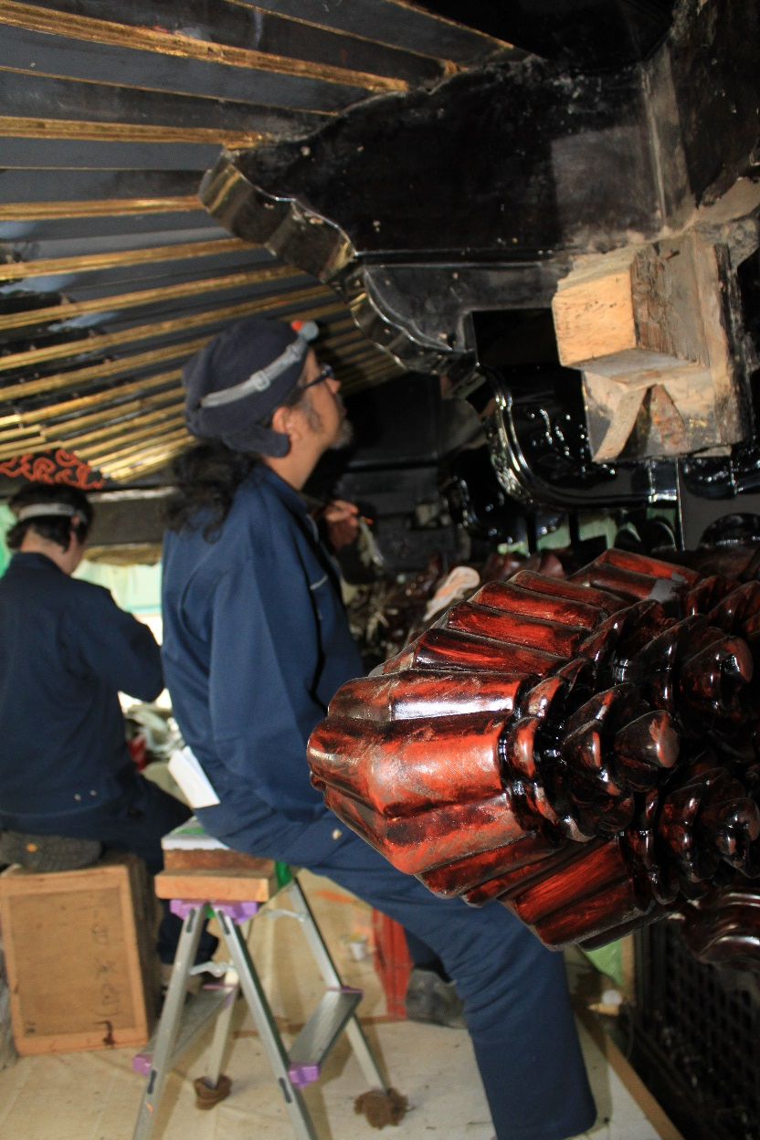
Excursion to Nikko Temples, Japan, May 2014

Slide 31
Thank you for your attention!
QUESTIONS?

